Slide 1

ANOVA (ANALYSIS OF VARIANCE)
ONE WAY ANOVA
-SREELAKSHMI SURESH PILLAI

Slide 2
introduction
A survey was conducted by the students of class SYBSc (C). In the survey, the data was collected for statistics project on the topic “ONE WAY ANOVA ALALYSIS”.
Analysis of variance (ANOVA) is a statistical technique that is used to check if the means of two or more groups are significantly different from each other. ANOVA checks the impact of one or more factors by comparing the means.
In this project, the test was conducted whether there is a significant difference in the health of an individual based on consuming Caffeine product in their meals (by calculating the BMI of each group).

Slide 3
DEFINITIONS
CAFFEINE PRODUCTS-Caffeine is a substance that’s naturally present in the leaves, seeds, and fruits of many plants. It’s naturally found in tea leaves, cocoa beans, coffee beans, and kola nuts. In addition, people add it to a variety of foods and drinks, including ice cream and energy bars.
Body mass index (BMI)- is a value derived from the mass (weight) and height of a person. The BMI is defined as the body mass divided by the square of the body height, and is expressed in units of kg/m², resulting from mass in kilograms and height in meters.

Slide 4
DATA COLLECTION AND DATA ANALYSIS
DATA COLLECTION-
The data was collected by google forms.
Collection of 50 responses in the survey were consider.
QUESTION ASKED-
Do you consume caffeine products in your routine?(includes coffee, tea, soda, energy drinks, green tea, chewing gum, cola, ice-cream, chocolate, supplements, etc,.)
DAILY, SOMETIMES, NEVER
Your weight (in kg)
Your height (in CMS)
DATA ANALYSIS-
WITH HELP OF GOOGLE FORM AND MS EXCEL

Slide 5

MATHEMATICAL MODEL FOR ONE-WAY ANOVA
$y_{ij}$=µ+$α_{i}+e_{ij}$ i=1,2,3,……,k
j=1,2,3,…..,$n_{i}$
$y_{ij}$=Value of $j^{th}$ observation taken on $i^{th}$ level of the factor
µ=General mean
$α_{i}$=effect of $i^{th}$ level
$e_{ij}$=Random error
ASSUMPTIONS-
1) Observations are taken independent
2) Observations follows normal distributions
3) All groups have same\equal variance
4) Σ$n_{i}$ $α_{i}$=0

Slide 6

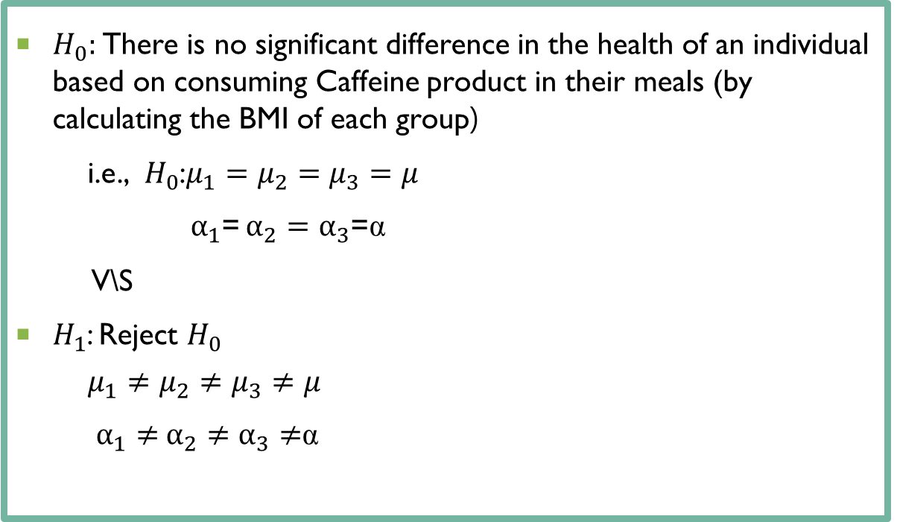
Hypothesis to be tested
$H_{0}:$There is no significant difference in the health of an individual based on consuming Caffeine product in their meals (by calculating the BMI of each group)
i.e., $H_{0}$:$μ_{1}=μ_{2}=μ_{3}=μ$
$α_{1}$= $α_{2}=$ $α_{3}$=α
V\S
$H_{1}$: Reject $H_{0}$
$$μ_{1}≠μ_{2}≠μ_{3}≠μ$$
$α_{1}≠$ $α_{2}≠$ $α_{3}≠$α

Slide 7
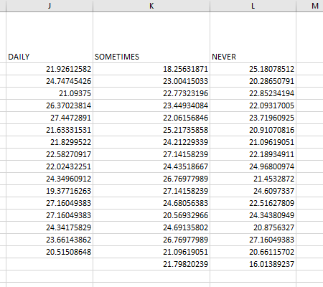
DATA

Slide 8
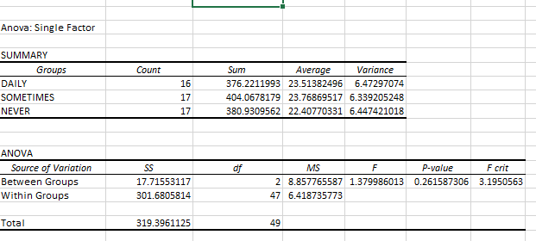

Anova analysis at 5% of significance
Decision
Reject $H_{0}$ if $F_{cal}$>$F_{tab}$
But here $F_{cal}$=1.37998601 and $F_{tab}$=3.19506
1.379986 $≯$3.19506
$∴$, Do not reject $H_{0}$ at 5% level of significance
$∴,$There is no significant difference in the health of an individual based on consuming Caffeine product in their meals

Slide 9
MEANS OF THE EACH CATEGORY

Slide 10
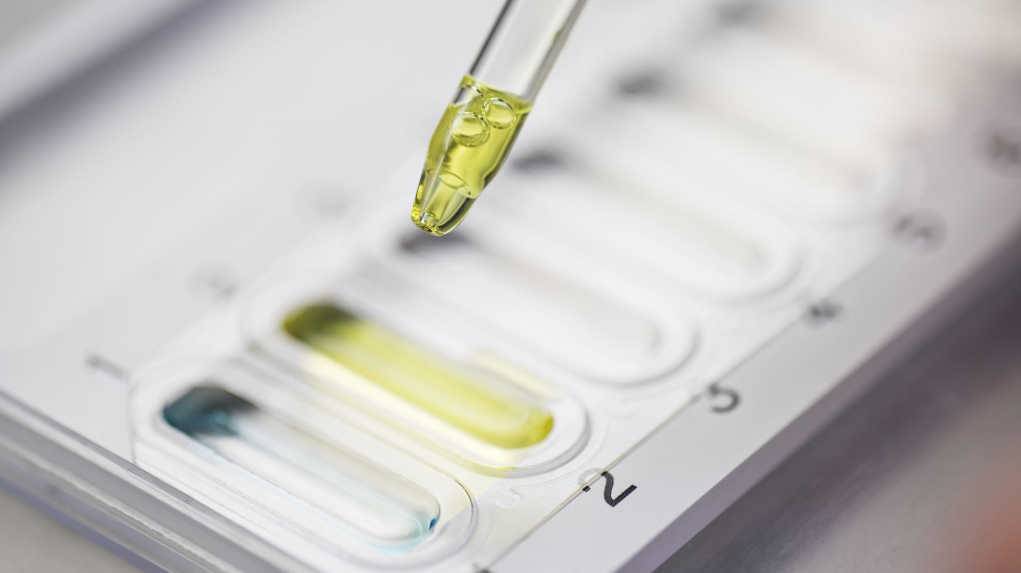

Pairing tests
$H_{0}$: $α_{i}$= $α_{i}^{′}$ V/S $H_{1}$: $α_{i}$≠ $α_{i}^{′}$
t= $\frac{\text{(}\overline{y_{i.}}\text{− }\overline{y_{i.}} ′\text{)}}{\sqrt{\frac{1}{n_{i}}+\frac{1}{{n′}_{i}}} ∗MSSE}$ $∼$ $t_{(n−k)}$
$t_{\frac{α}{2}}$(n-k)= $t_{\frac{α}{2}}$(49)= 2.010
We reject $H_{0}$ if │ $\overline{y_{i.}}\text{− }\overline{y_{i.}} ′$│ > $t_{\frac{α}{2}}$(n-k) $\sqrt{\frac{1}{n_{i}}+\frac{1}{{n′}_{i}}} ∗MSSE$
i.e. reject $H_{0}$ if │ $\overline{y_{i.}}\text{− }\overline{y_{i.}} ′$│ > 2.010 $\sqrt{\frac{1}{n_{i}}+\frac{1}{{n′}_{i}}}$ *6.41873773

Slide 11
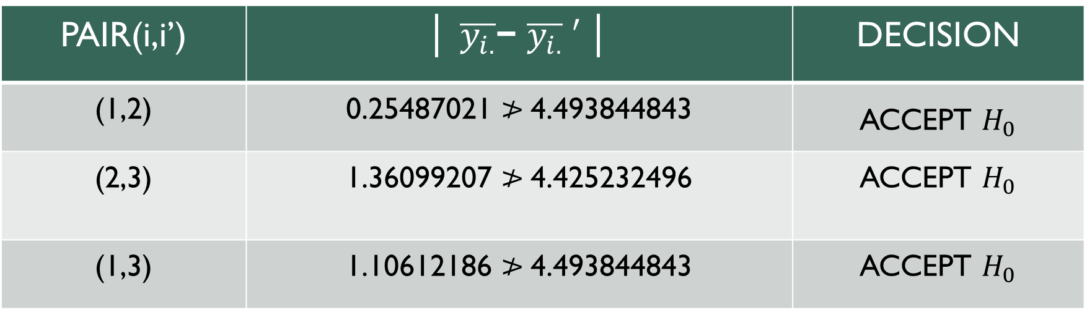
PAIR(i,i’) | │ $\overline{y_{i.}}\text{− }\overline{y_{i.}} ′$│ | DECISION
(1,2) | 0.25487021 $≯$4.493844843 | ACCEPT $H_{0}$
(2,3) | 1.36099207 $≯$4.425232496 | ACCEPT $H_{0}$
(1,3) | 1.10612186 $≯$4.493844843 | ACCEPT $H_{0}$
From this we can say that all pairs ARE NOT significantly DIFFER.

Slide 12
THANK YOU
FOR YOUR ATTENTION

